Slide 1
8086 Interrupts

Slide 2
Introduction
Most Microprocessors allow normal program execution to be interrupted by some external signal or by a special instruction in the program.
In response to an interrupt, the microprocessor stops executing it’s current program and call a procedure which serves the interrupt.

Slide 3
Sources
An 8086 interrupt can come from any one of the three sources.
External signal applied to NMI pin or INTR input pin . . . . Hardware interrupt
Execution of Interrupt instruction, INT . . . . software interrupt
Some error condition produced by executing an instruction i.e. divide by zero

Slide 4
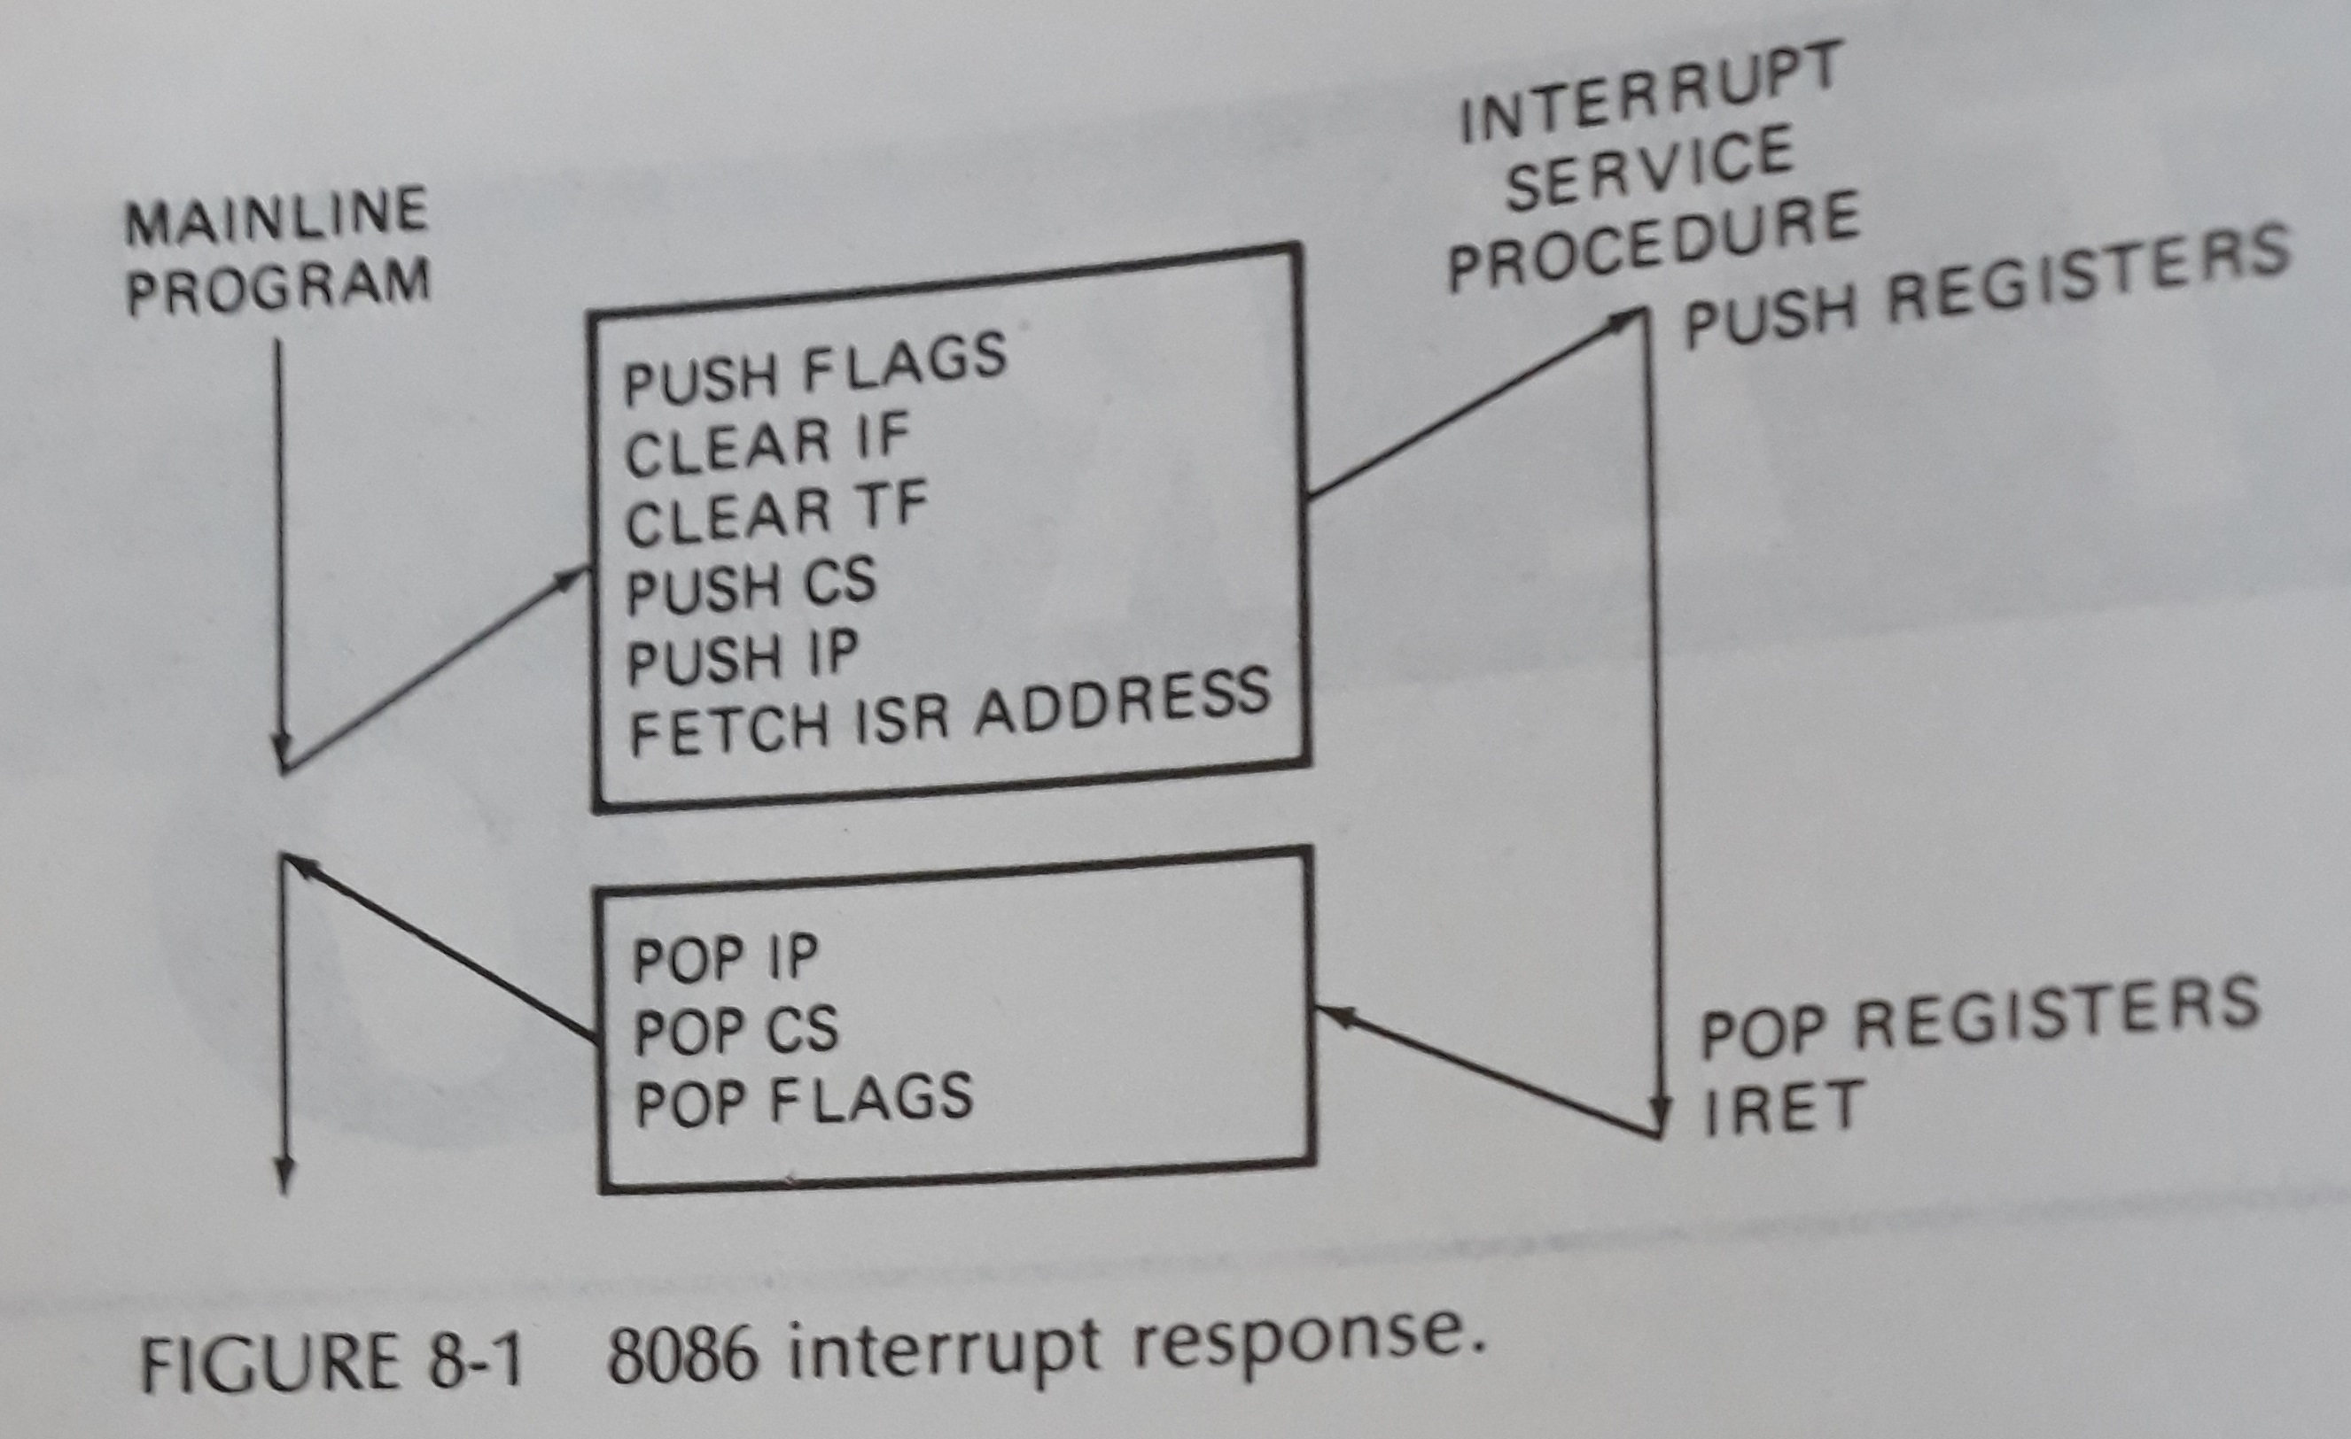
8086 Interrupt Response

Slide 5
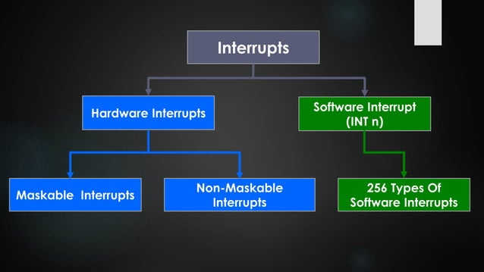

Slide 6
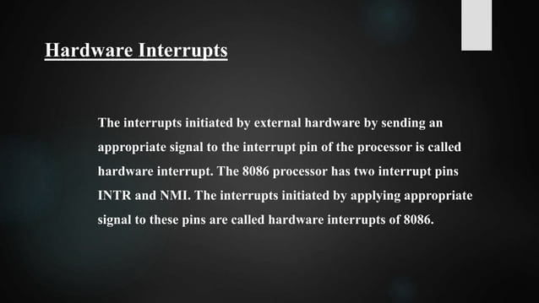

Slide 7
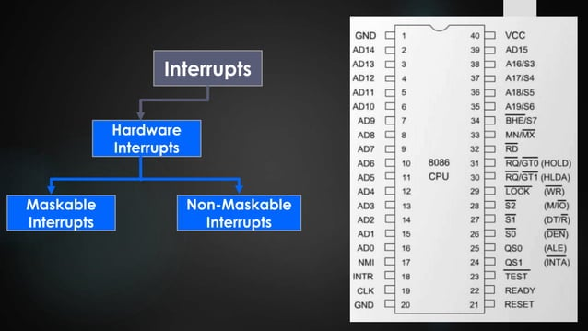

Slide 8
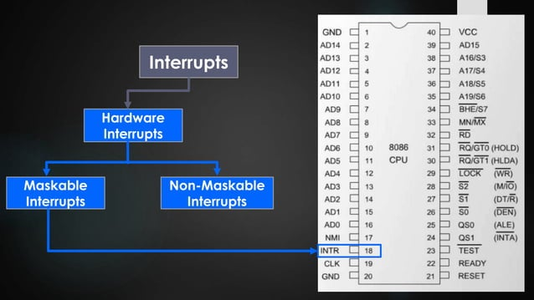

Slide 9
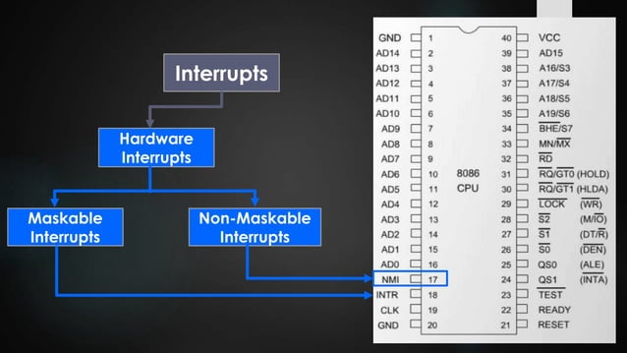

Slide 10
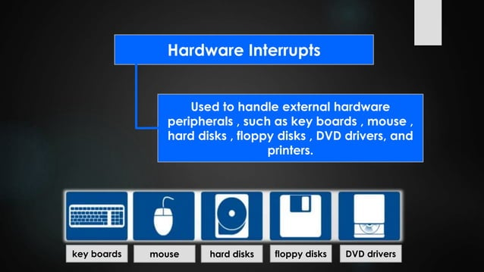

Slide 11
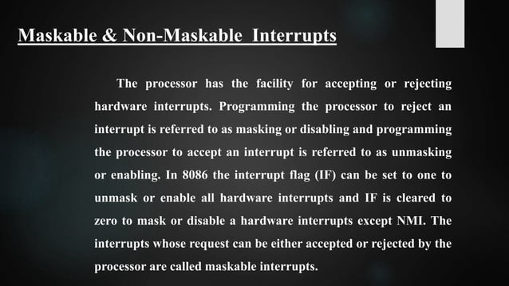

Slide 12
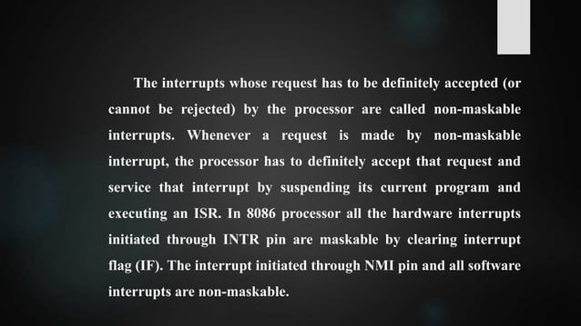

Slide 13
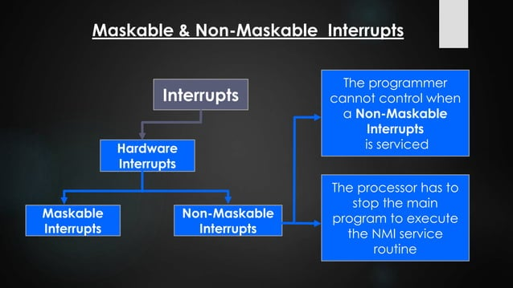

Slide 14
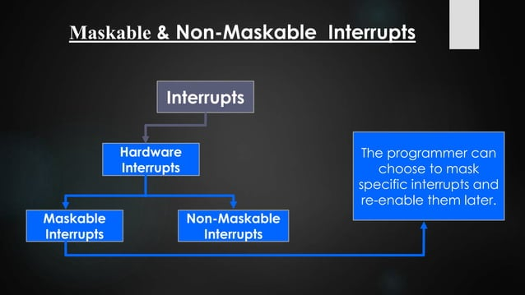

Slide 15
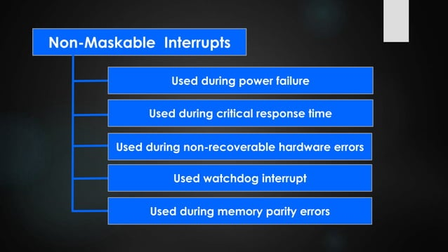

Slide 16
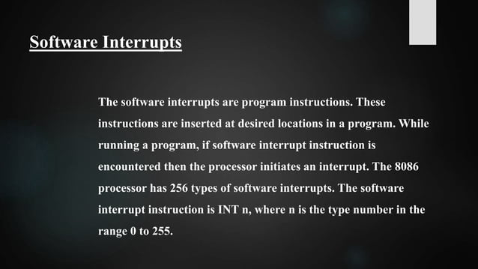

Slide 17
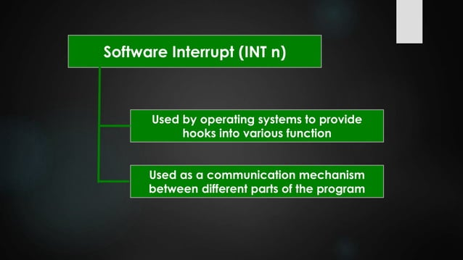

Slide 18
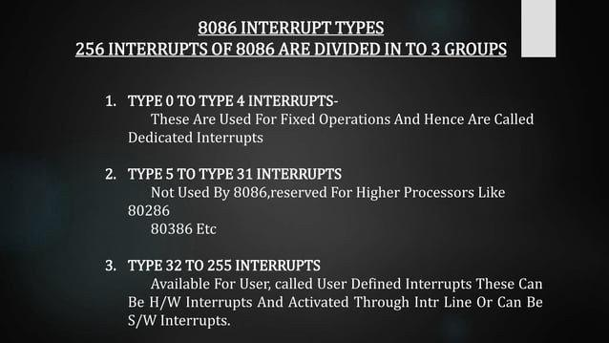

Slide 19
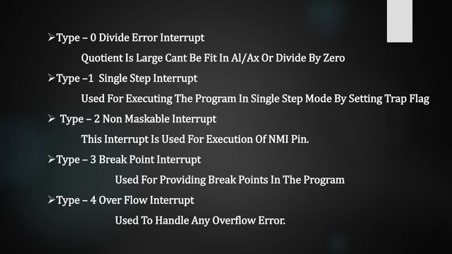

Slide 20
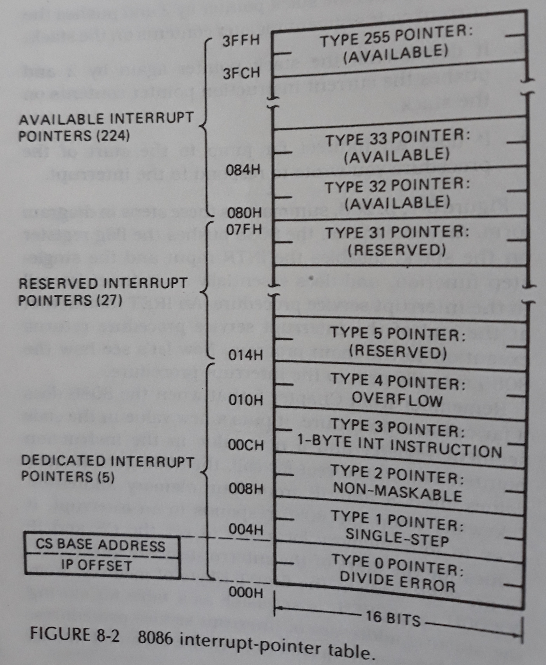
8086 interrupt-pointer table

Slide 21
Divide-By-Zero Interrupt- type 0
Result of DIV or IDIV operation is too large to fit in destination register
Type 0
Get ip and cs from 00000h and 00002h

Slide 22
Software Interrupts
INT instruction can be used to cause the 8086 to do any one of the 256 possible interrupt types.

Slide 23
IF (Interrupt Flag) is automatically cleared as part of the response of an 8086 to an interrupt.

Slide 24
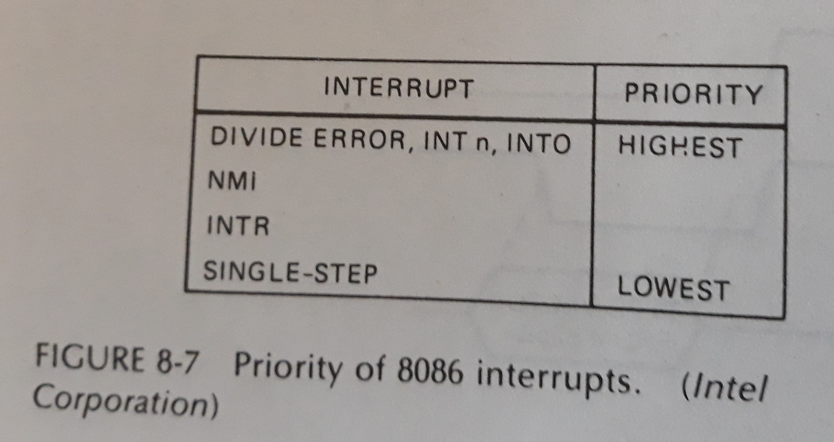
Priority of 8086 Interrupts

Slide 25
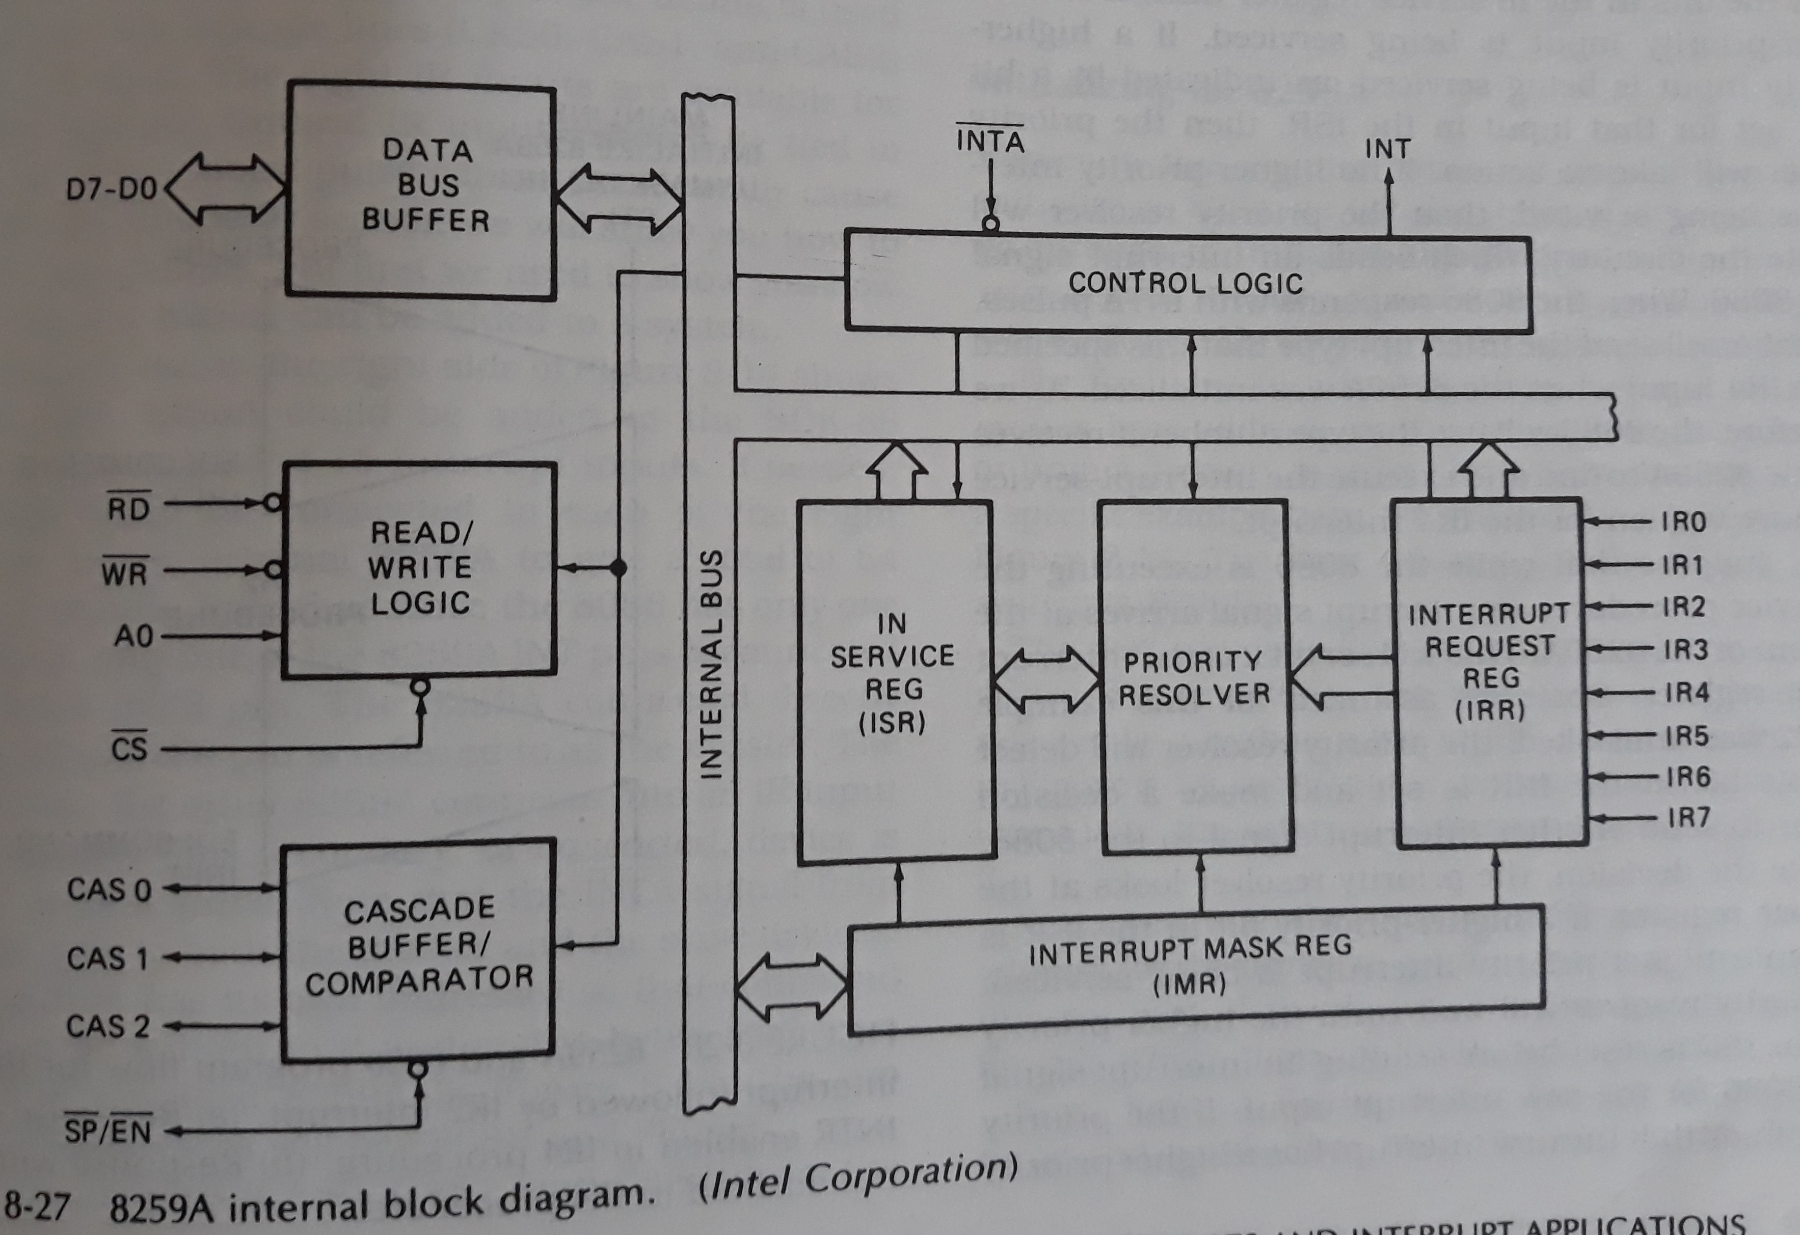
8259A Priority Interrupt Controller

